Slide 1
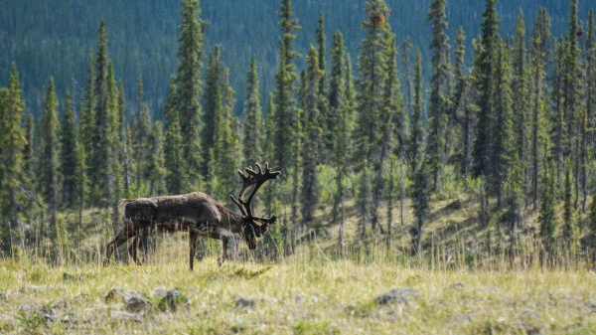
BEACONs Movement Explorer App
June 24, 2025

Slide 2
Purpose of the app
The BEACONs Movement Explorer is an R/Shiny app intended to be used as part of a workflow for exploring and analyzing movement data. The app can help users to:
Visualize animal locations and trajectories
Summarize GPS-based sampling characteristics
Define seasonal and migration periods
Estimate seasonal and annual home ranges
Identify seasonal movement corridors (paths)

Slide 3
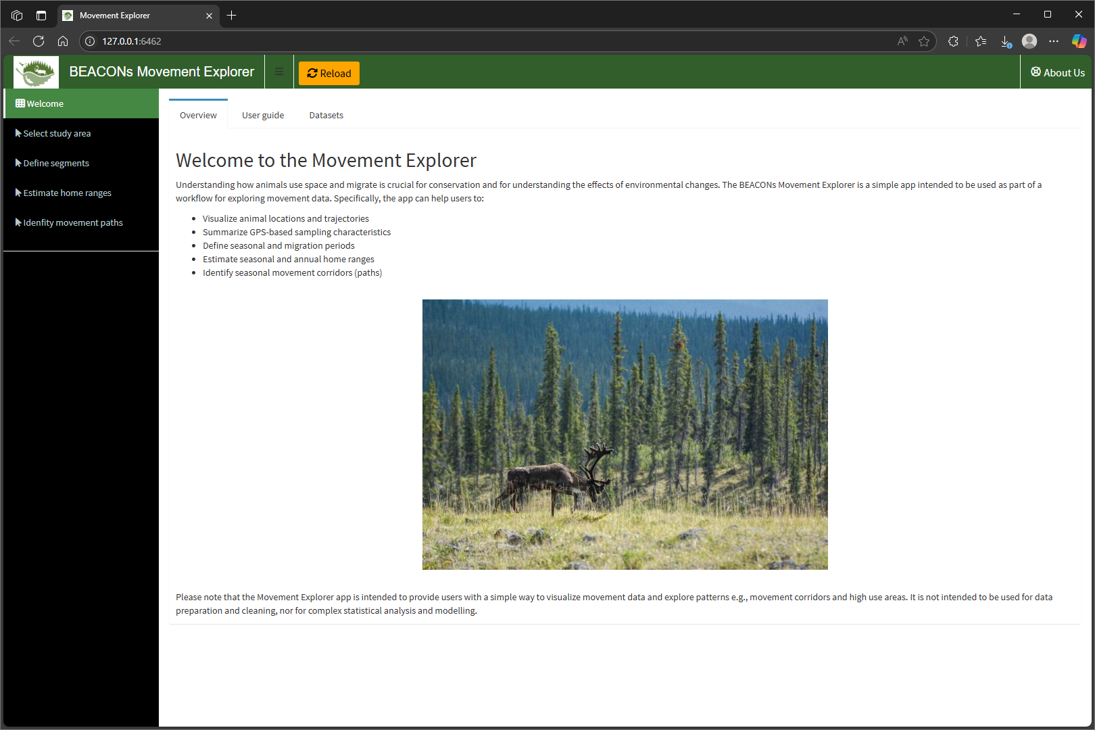
Welcome – Overview

Slide 4
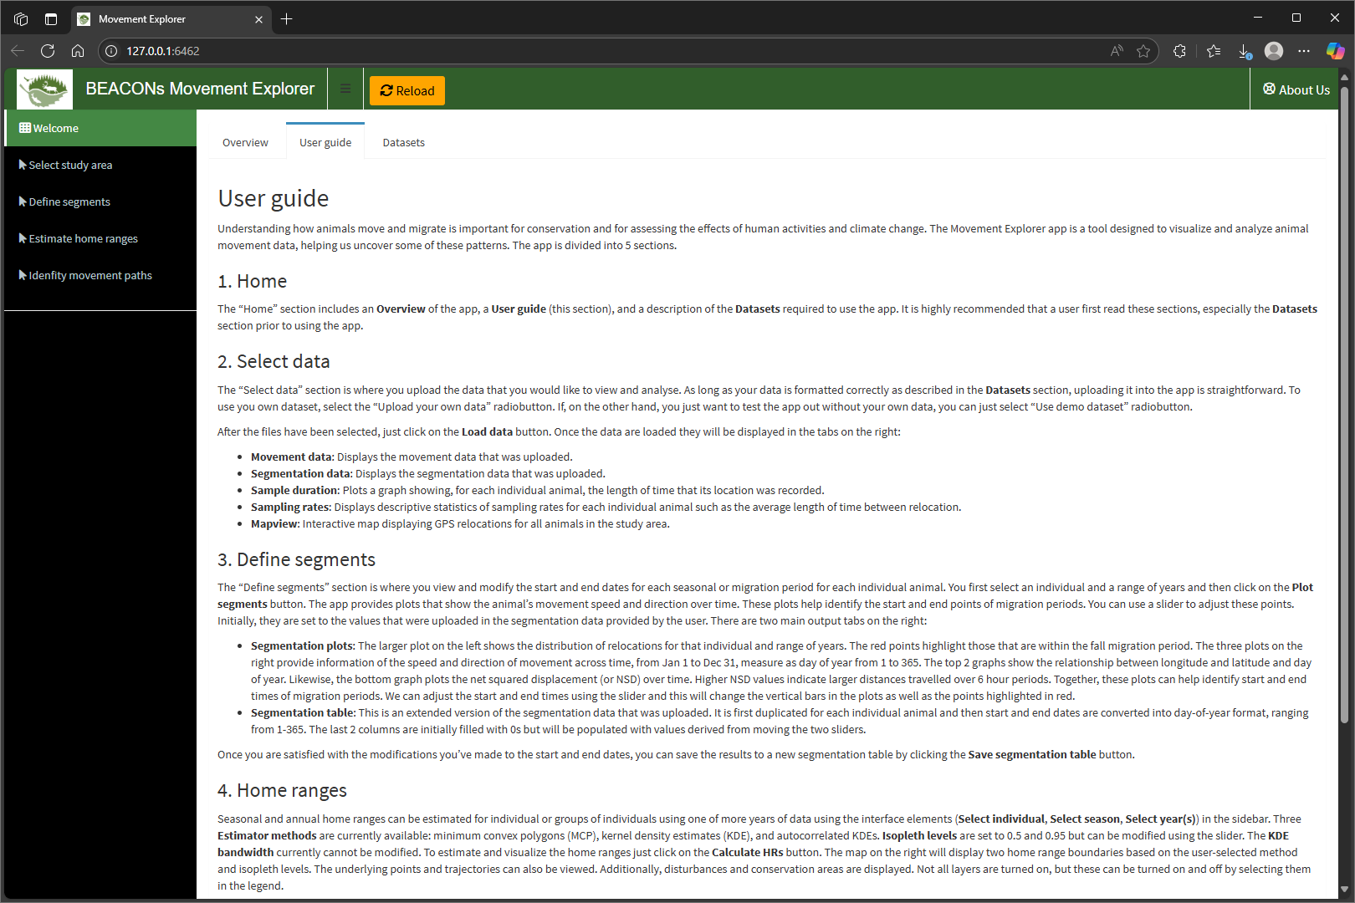
Welcome – User guide

Slide 5
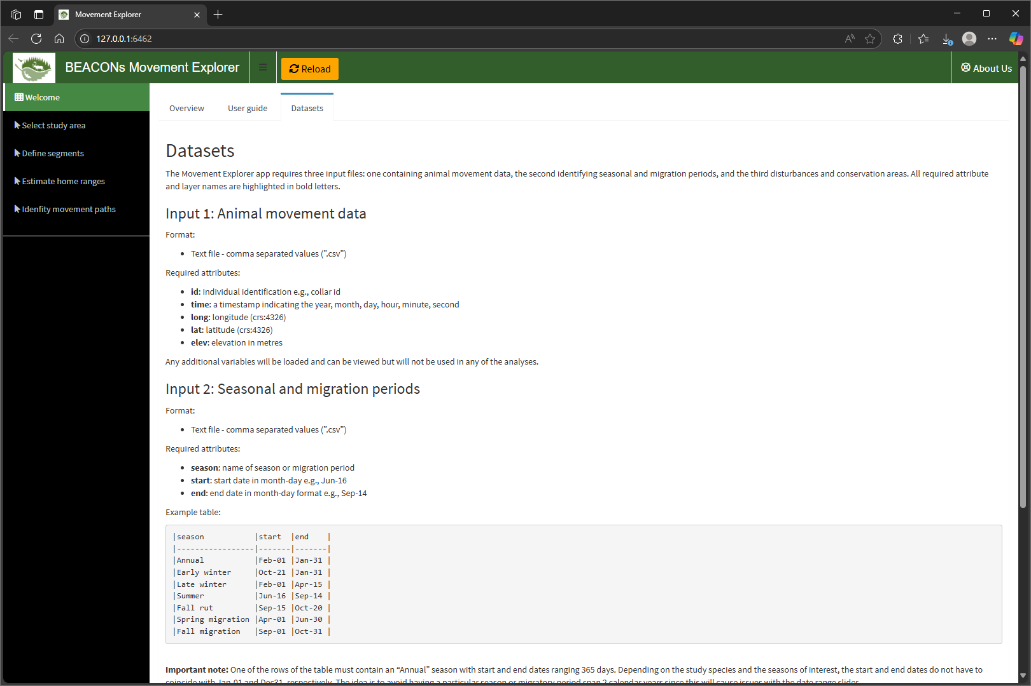
Welcome – Datasets

Slide 6
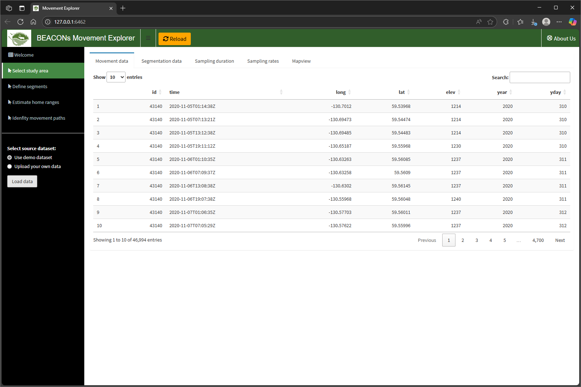
Select study area – Movement data

Slide 7
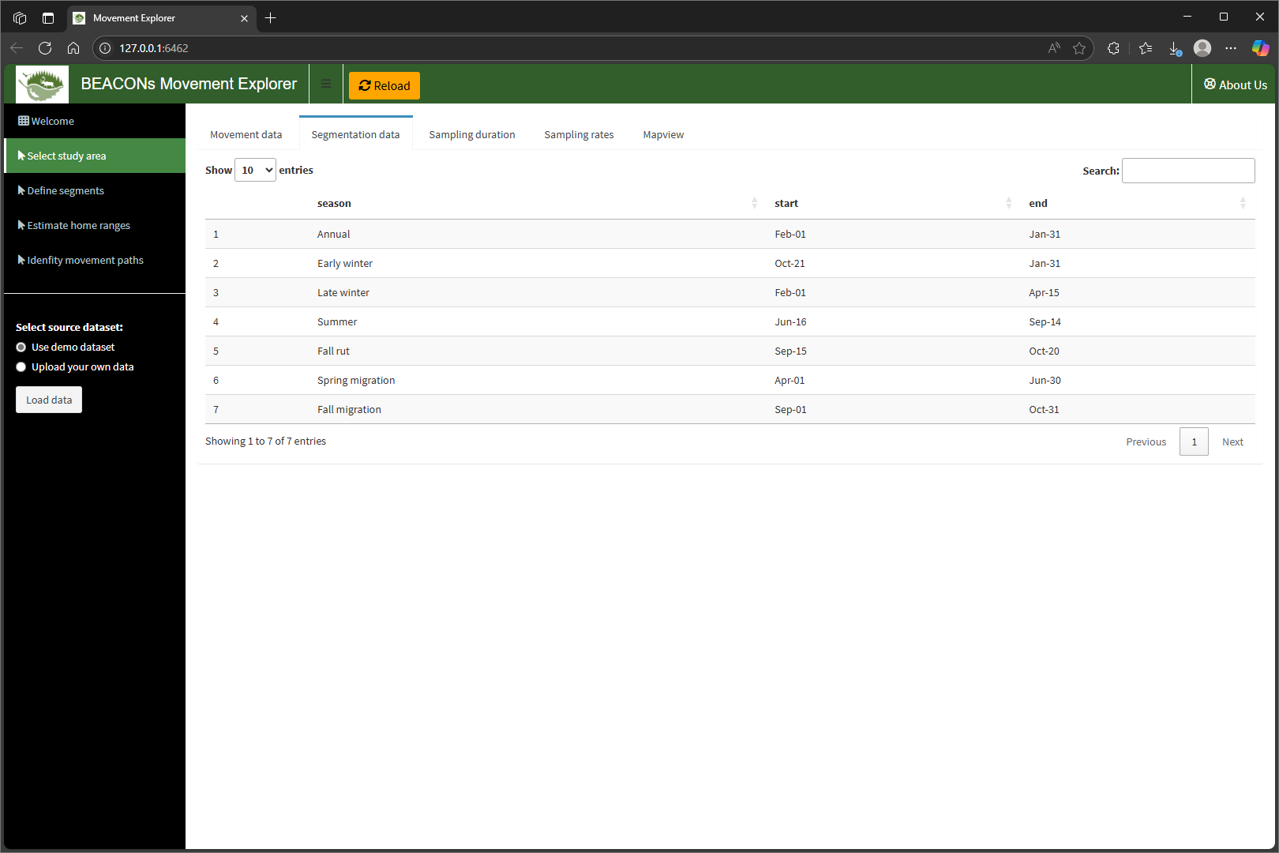
Select study area – Segmentation data

Slide 8
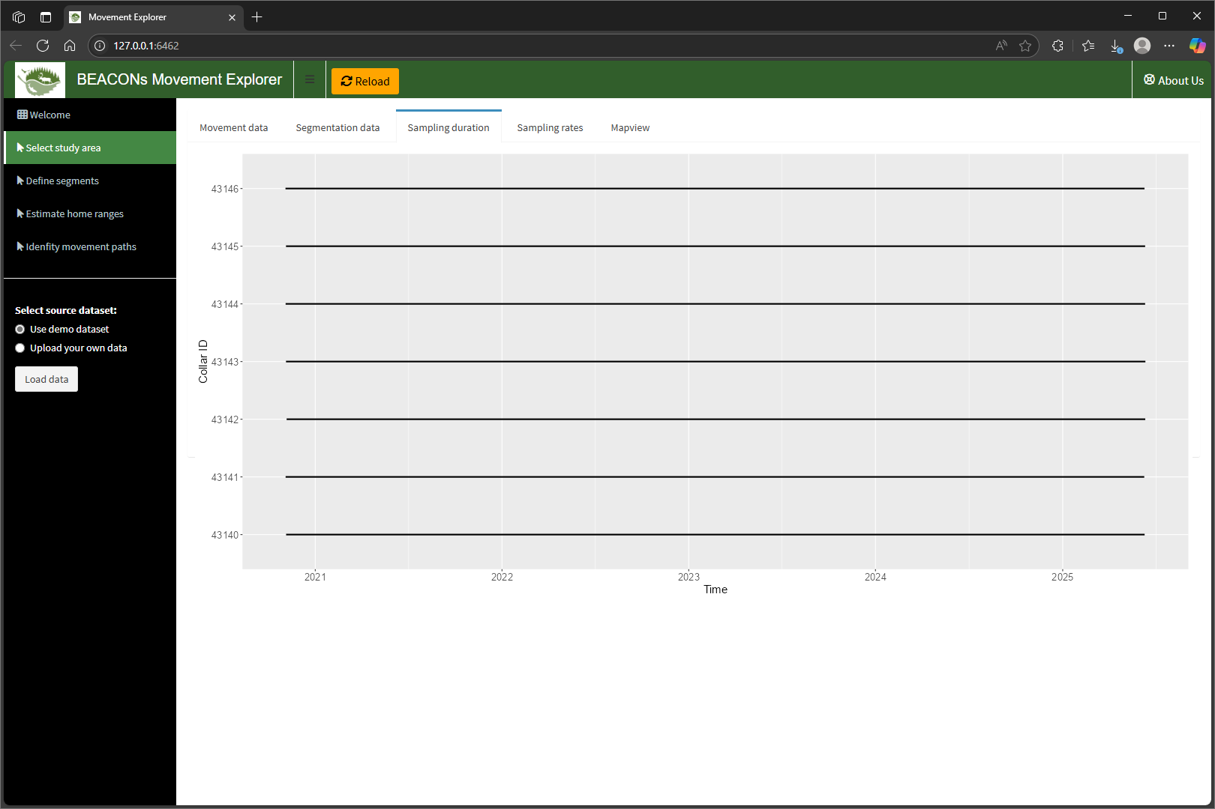
Select study area – Sampling duration

Slide 9

Select study area – Sampling rates

Slide 10
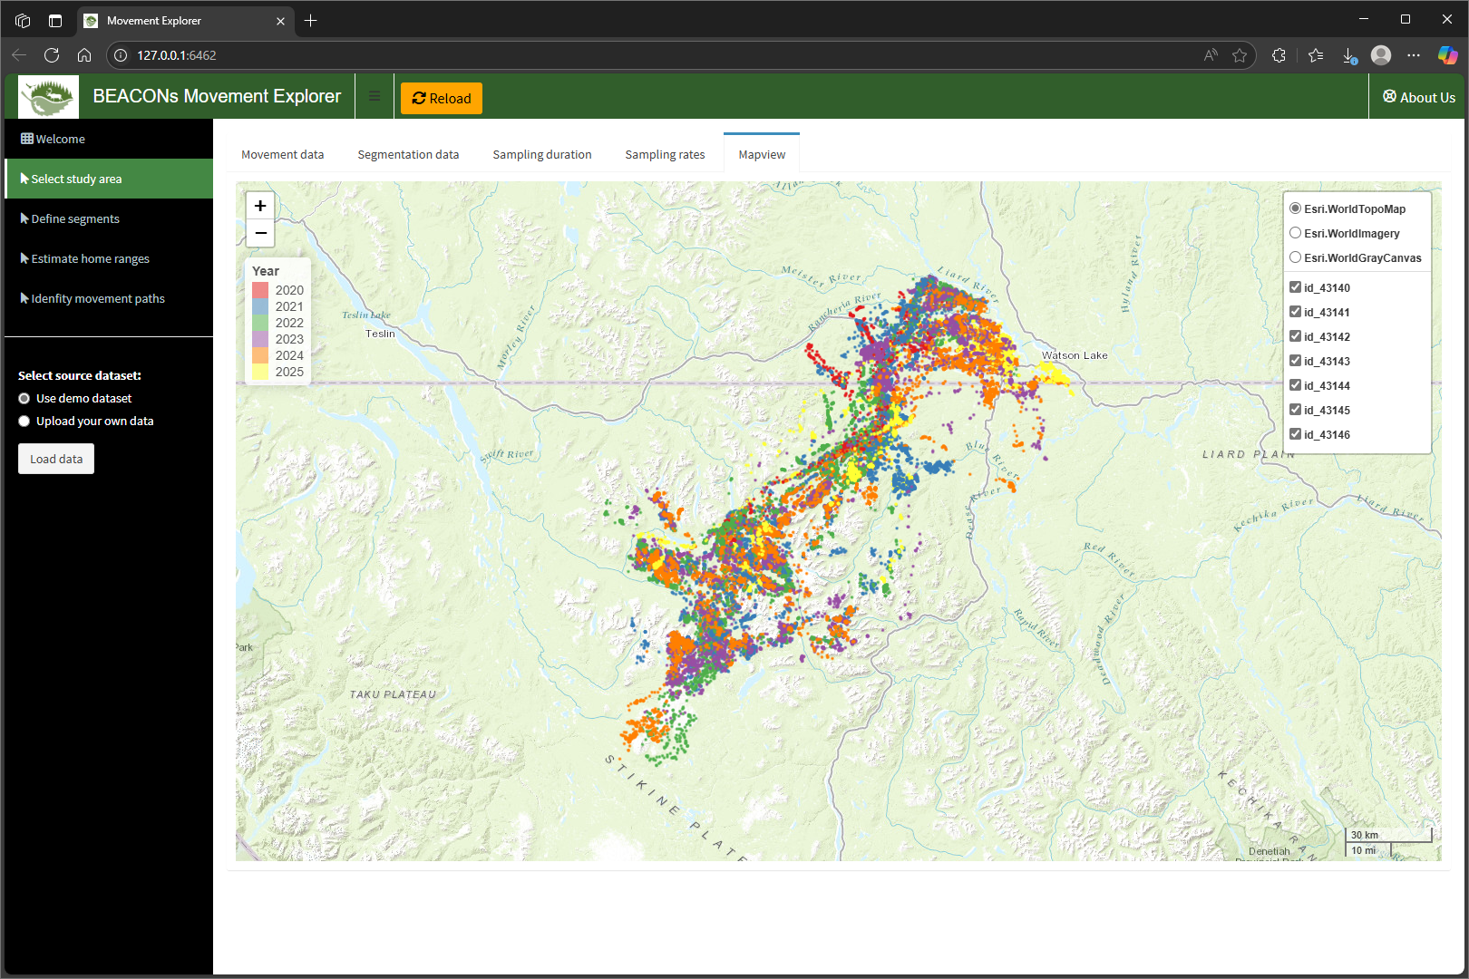
Select study area – Mapview

Slide 11
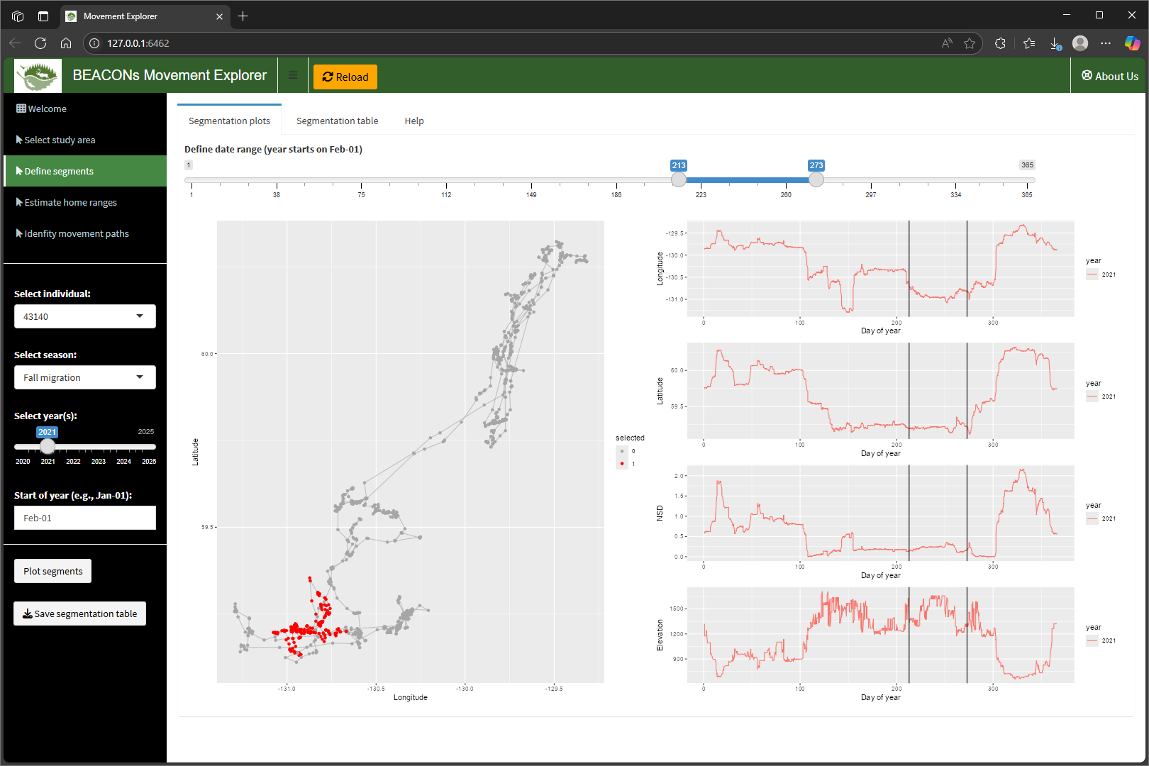
Define segments – Segmentation plots

Slide 12
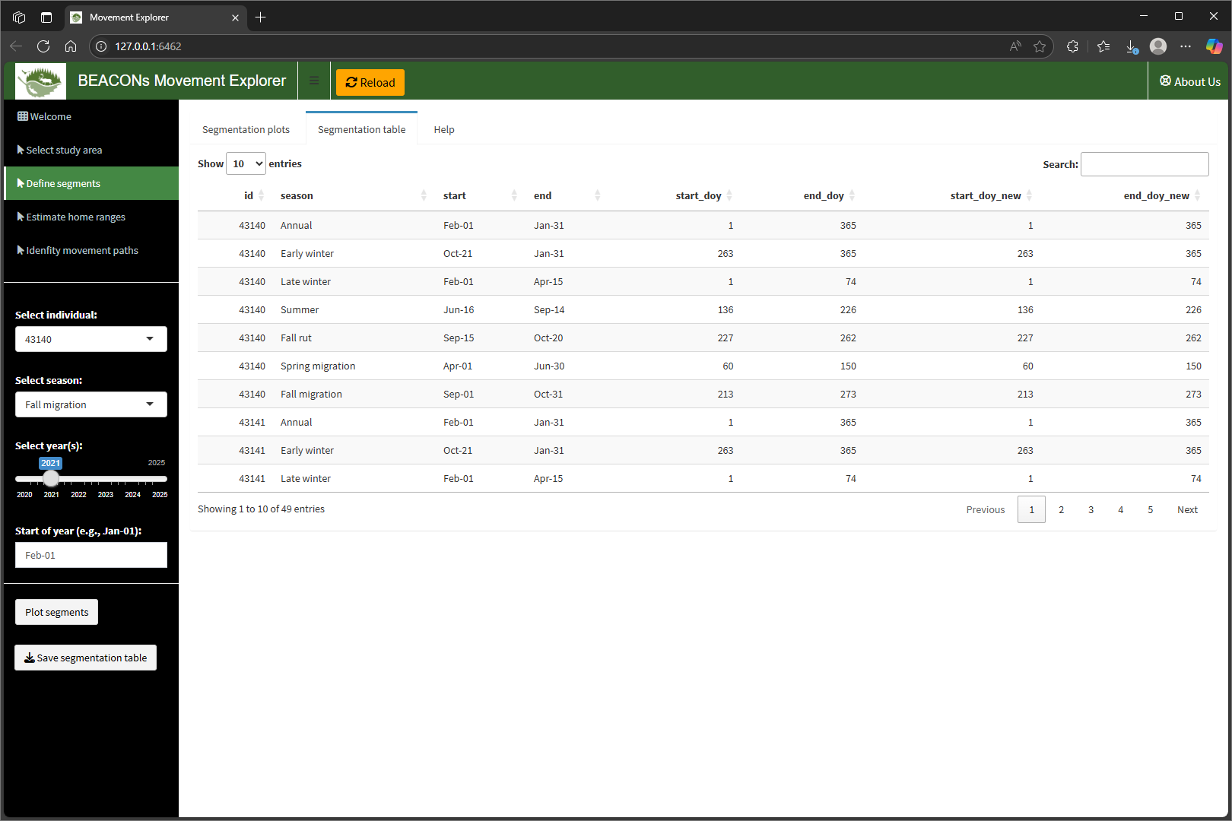
Define segments – Segmentation table

Slide 13

Define segments – Help

Slide 14
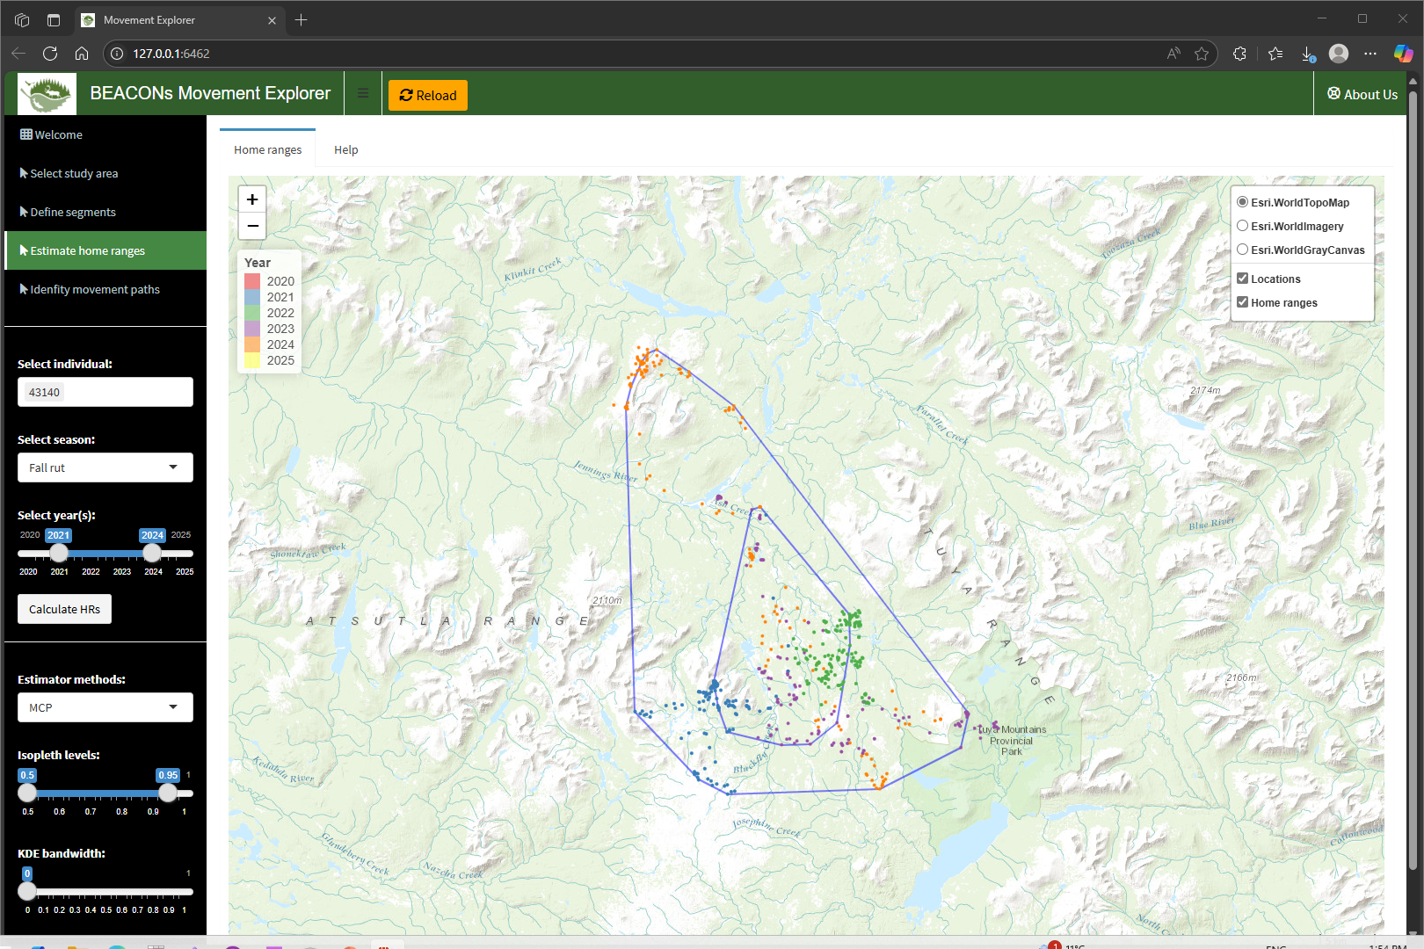
Estimate home ranges – Home ranges

Slide 15
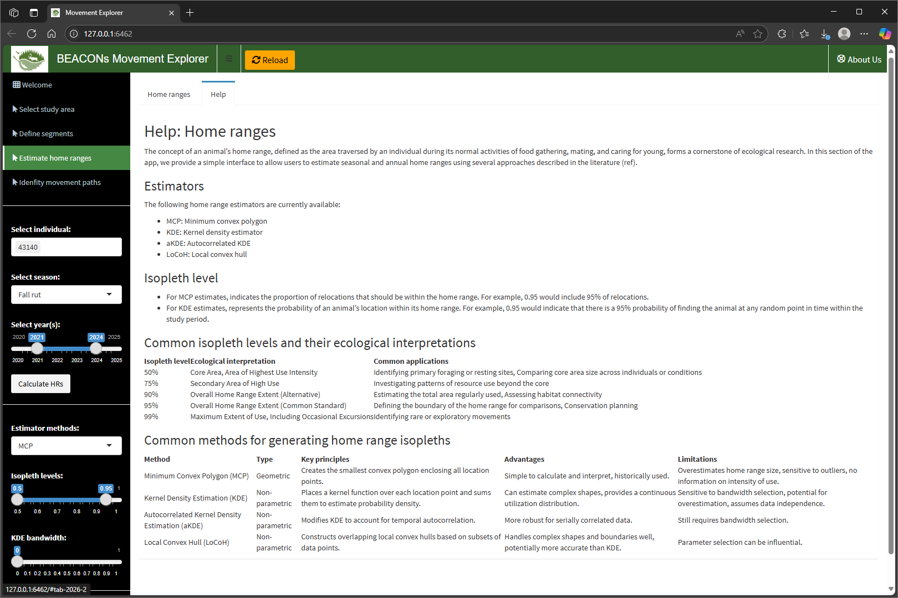
Estimate home ranges – Help

Slide 16
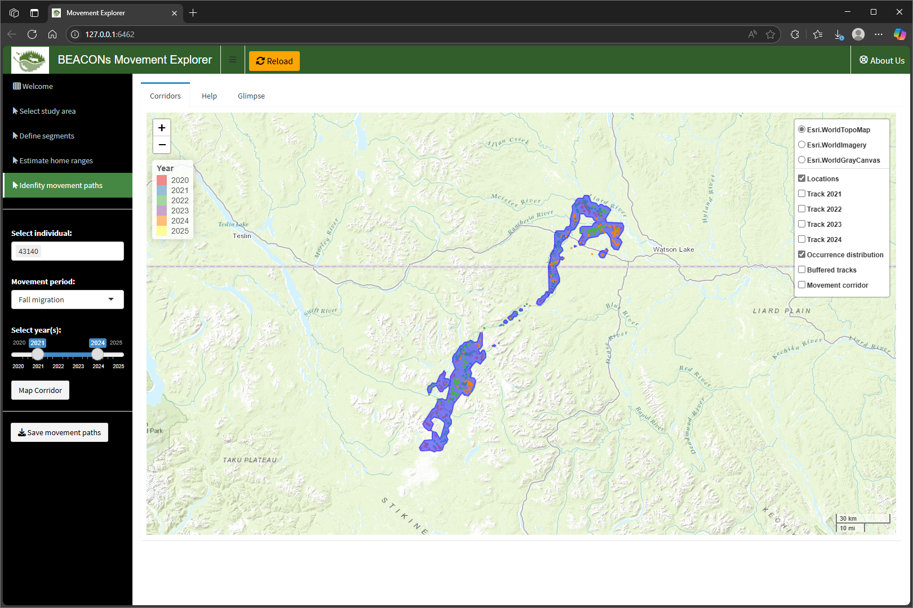
Identify movement paths – Corridors

Slide 17
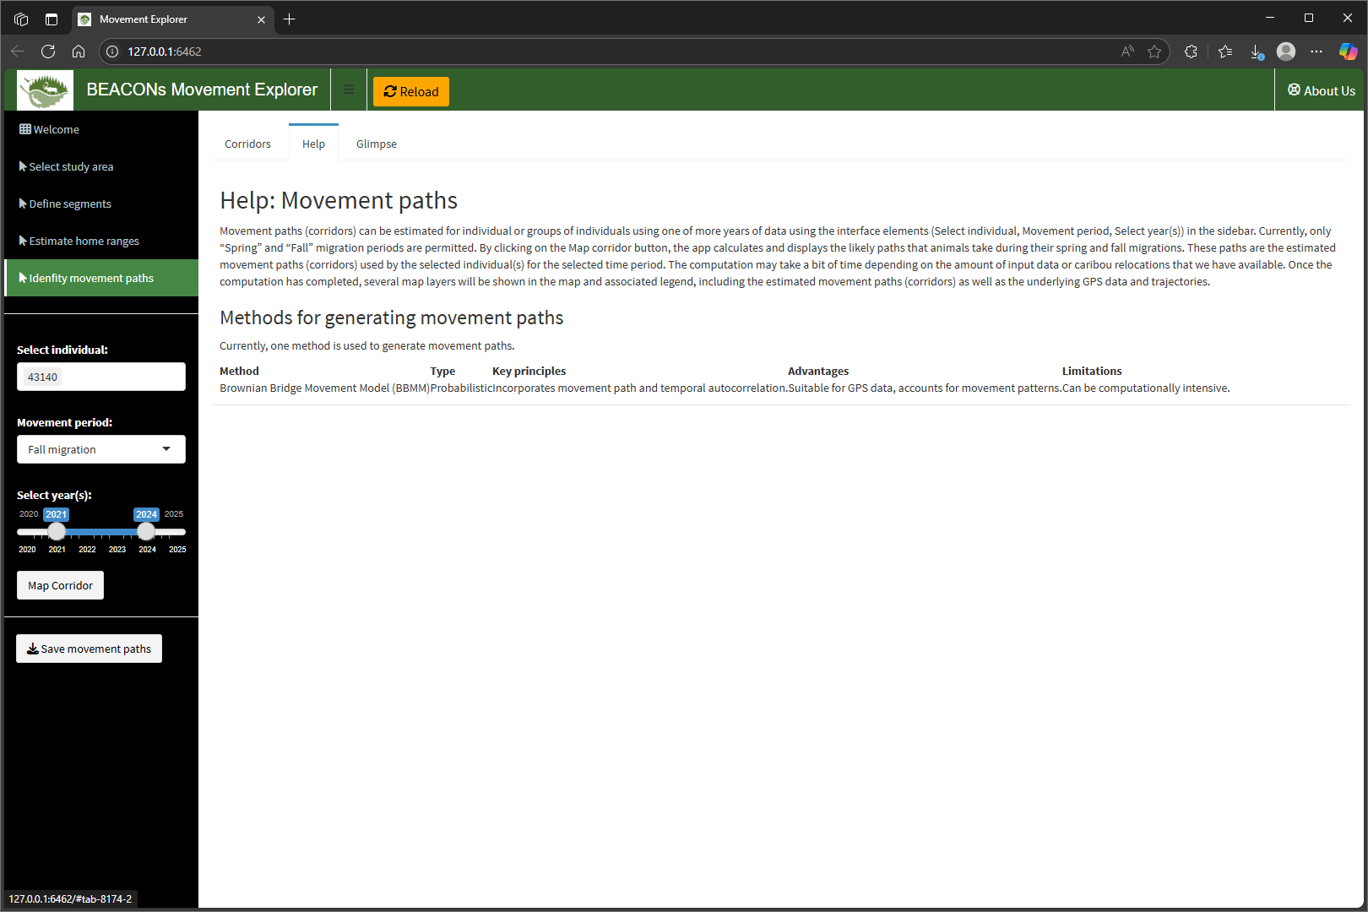
Identify movement paths – Help

